Slide 1


S5-6. Introduction To Motor Vehicle Maintenance
This Vocationally Related course is designed to engage and motivate 15-19 year-olds who are interested in learning about the automotive maintenance industry. This course requires the learner to complete an Eportfolio to record the knowledge and skills attained. This can be completed on a mobile smart phone, tablet, laptop etc. Students will also have access to Elearning course material allowing for study on the move.

Slide 2

Unit L1AM01: Health and Safety in the Workplace
This unit enables learners to develop knowledge, understanding and skills of the health and safety requirements when carrying out simple maintenance and repair tasks in the workplace. This unit covers the general requirements of health and safety in the workplace including personal responsibilities, common hazards and risks, manual handling, health and safety information, fire prevention and emergency evacuation procedures.

Slide 3
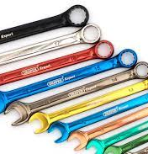
Unit L1AM02: Tools, Equipment and Consumable Materials for Vehicle Maintenance
This unit enables learners to develop knowledge, understanding and skills relating to the use of common tools and equipment used for vehicle maintenance and repairs; the unit also covers the appropriate selection and use of consumable materials used during these activities.

Slide 4
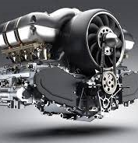
Unit L1AM03: Engine Operation and Components
This unit enables learners to develop knowledge, understanding and skills associated with the basic operation of common internal combustion engines and components. The unit also requires learners to carry out routine engine maintenance procedures.

Slide 5
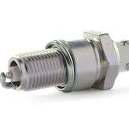
Unit L1AM06: Spark Ignition System Components and Maintenance
This unit enables learners to develop knowledge, understanding and skills associated with the basic operation of spark ignition system components. This unit also requires learners to carry out routine spark ignition maintenance procedures.

Slide 6
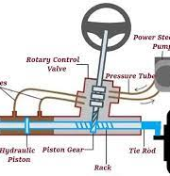
Unit L1AM10: Steering System Components and Maintenance
This unit enables learners to develop knowledge, understanding and skills associated with the basic operation of steering system components. This unit also requires learners to carry out routine steering system maintenance procedures.

Slide 7
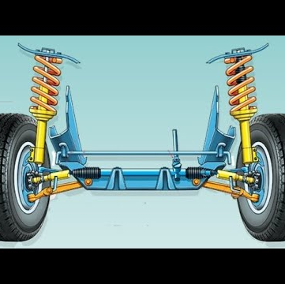
Unit L1AM11: Suspension System Components and Maintenance
This unit enables learners to develop knowledge, understanding and skills associated with the basic operation of suspension system components. This unit also requires learners to carry out routine suspension system maintenance procedures.

Slide 8
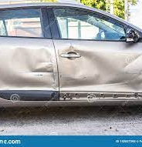
S5-6. INTRODUCTION TO AUTOMOTIVE BODY REPAIR & REFINISHING
This Vocationally Related course is designed to engage and motivate 15-19 year-olds who are interested in learning about the automotive repair industry. This course requires the learner to complete an eportfolio to record the knowledge and skills attained. This can be completed on a mobile smart phone, tablet, laptop etc. Students will also have access to elearning course material allowing for study on the move.

Slide 9
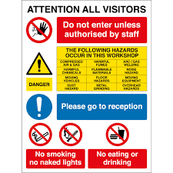
L1AM01 Health and Safety in the Workplace
This unit enables learners to develop knowledge, understanding and skills of the health and safety requirements when carrying out simple maintenance and repair tasks in the workplace. This unit covers the general requirements of health and safety in the workplace including personal responsibilities, common hazards and risks, manual handling, health and safety information, fire prevention and emergency evacuation procedures.

Slide 10
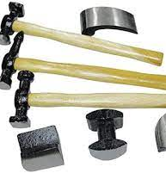
L1AM02 Tools, Equipment and Consumable Materials for Vehicle Maintenance
This unit enables learners to develop knowledge, understanding and skills relating to the use of common tools and equipment used for vehicle maintenance and repairs; the unit also covers the appropriate selection and use of consumable materials used during these activities.

Slide 11
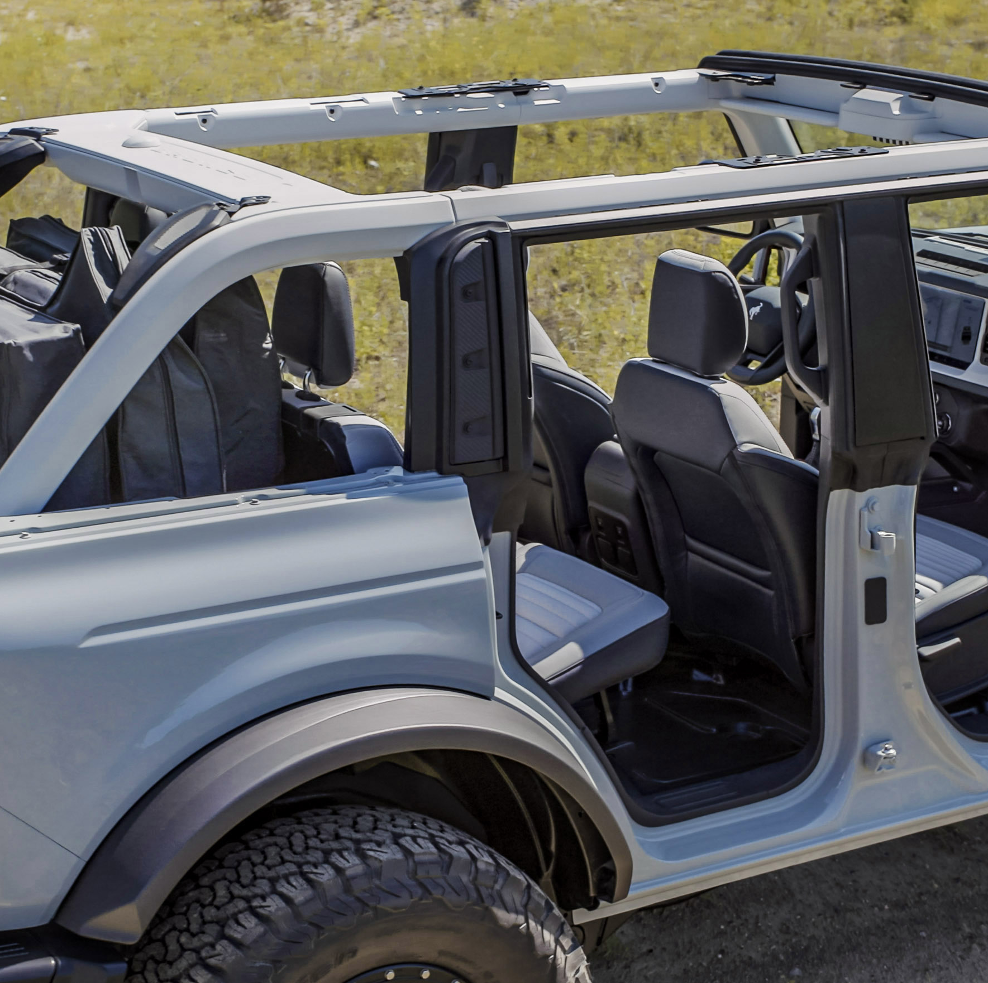
L1AR04 Panel Removal and Refitting
This unit enables learners to develop knowledge, understanding and skills associated with the removal and refitting of vehicle body panels which are secured with mechanical fastenings. The unit also requires learners to demonstrate how to isolate electrical systems associated with panel removal and refitting.

Slide 12
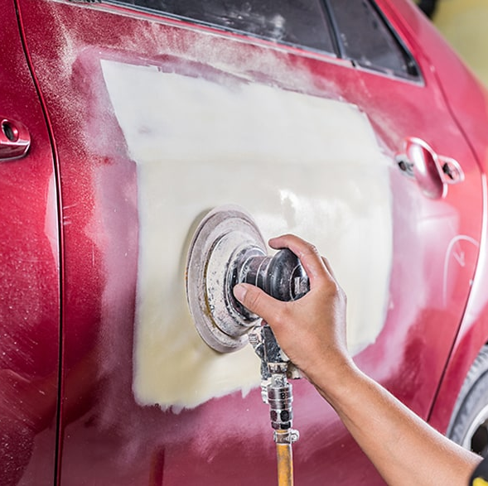
L1AR05 Minor Panel Damage Repairs
This unit enables learners to develop knowledge, understanding and skills associated with raising and shaping a minor dent which is located on a flat section of a vehicle panel. This unit also requires learners to demonstrate their skills in mixing, applying and shaping body fillers.

Slide 13
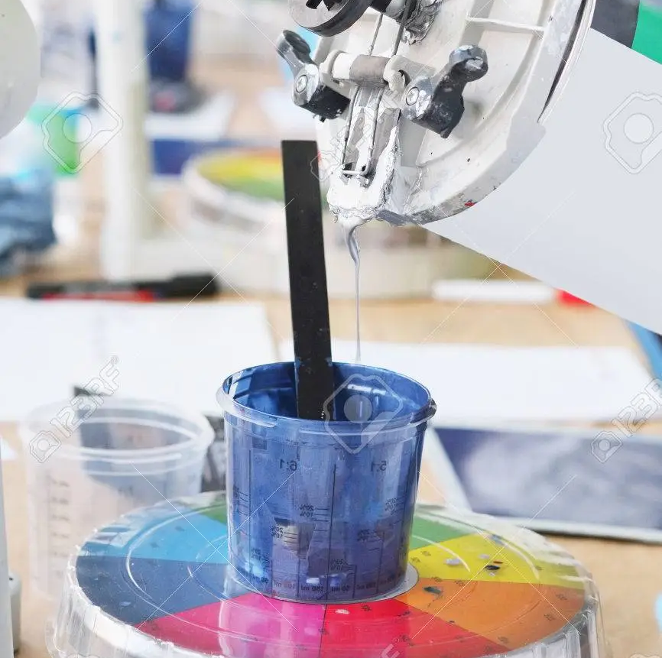
L1AR09 Vehicle Paint Preparation
This unit enables learners to develop knowledge, understanding and skills associated with preparing a previously painted steel surface using hand and machine sanding methods. This unit also requires learners to demonstrate their skills in using a range of abrasives whist carrying out paint preparation.

Slide 14
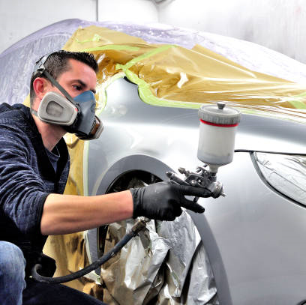
L1AR12 Primer Preparation and Application Techniques
This unit enables learners to develop knowledge, understanding and skills associated with preparing unpainted and previously painted steel panels and applying primers and sealers to a small vehicle panel in a vertical position. This unit also requires learners to demonstrate their skills in selecting and using technical information, mixing and applying primers and sealers.

